Slide 1
NAAN MUDHALVAN
ALIMUDEEN KANI

Slide 2

The Invisible Threat of Keyloggers
In the digital age, keyloggers - secretly installed software that track every keystroke - pose a grave threat to our privacy, security, and financial well-being. These stealthy programs can capture sensitive information, enabling identity theft, monetary loss, and breaches of confidentiality.
Notes:
<number>

Slide 3

What Are Keyloggers and How Do They Work?
1
Hidden Monitoring
2
Covert Installation
Keyloggers silently record every keystroke made on a computer, capturing passwords, credit card numbers, and other private data.
Keyloggers can be surreptitiously installed through malware, physical access, or even bundled with legitimate software.
3
Remote Access
The recorded data is then transmitted to the attacker, often in real-time, allowing them to exploit the stolen information.
Notes:
<number>

Slide 4
The Dangers of Keyloggers
Identity Theft
Financial Loss
Privacy Breaches
Keyloggers can capture login credentials, credit card numbers, and other sensitive personal information, enabling identity thieves to wreak havoc.
With access to online banking and payment information, keyloggers can lead to the theft of funds and financial ruin.
Keyloggers can expose private communications, browsing history, and other confidential data, compromising an individual's right to privacy.
Notes:
<number>

Slide 5
Common Keylogger Distribution Methods
Malicious Software
Physical Access
Keyloggers can be bundled with malware, tricking users into installing them unknowingly.
Keyloggers can be planted on devices through physical tampering, such as at public computers or shared workstations.
Legitimate Software
Social Engineering
Some keyloggers are distributed through seemingly harmless programs, taking advantage of users' trust.
Attackers may use deceptive tactics to convince victims to install keyloggers, such as through phishing emails or fraudulent software updates.
Notes:
<number>

Slide 6
Recognizing Keylogger Infections
Slow Performance
1
Keyloggers can cause a noticeable decrease in computer speed and responsiveness.
2
Unexplained Processes
Monitoring running processes may reveal suspicious programs with unfamiliar names.
Unusual Network Activity
3
Keyloggers often transmit data in the background, leading to increased internet traffic.
Notes:
<number>

Slide 7




Protecting Against Keyloggers
Antivirus Software
Encryption
Biometric Authentication
Monitoring
Use encryption tools to protect sensitive data and prevent keyloggers from capturing it.
Regularly monitor system processes and network activity to detect any suspicious behavior.
Install and maintain robust antivirus programs to detect and remove keyloggers.
Utilize biometric security measures, such as fingerprint or facial recognition, to bypass keylogging.
Notes:
<number>

Slide 8




Conclusion: Staying Vigilant
Awareness
Proactive Protection
Reporting Incidents
Educate yourself and others about the dangers of keyloggers to stay alert.
Implement robust security measures to safeguard your devices and information.
Report any suspected keylogger activity to the appropriate authorities to help combat this threat.
Notes:
<number>

Slide 9
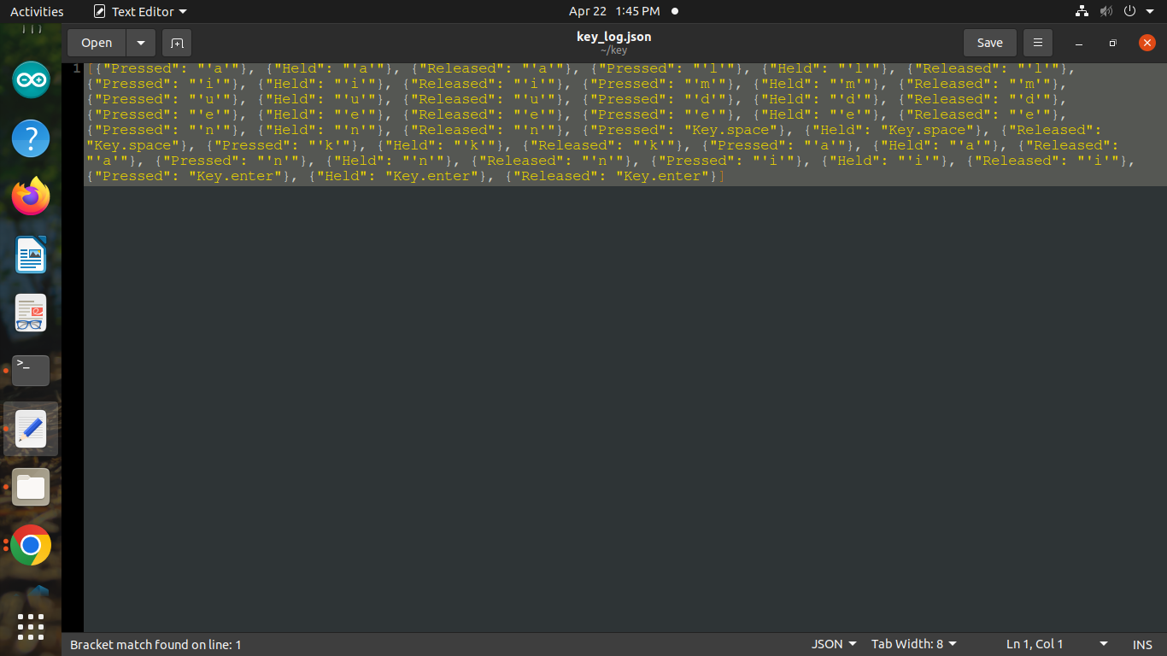
RESULT:

Slide 10
The Future of Keylogger Defense
Advancements in AI-Powered Detection
Leveraging machine learning algorithms to identify and neutralize keyloggers in real-time.
Biometric Authentication Enhancements
Developing more reliable and secure biometric security measures to bypass keylogging.
Quantum-Resistant Encryption
Implementing encryption technologies that are impervious to the computational power of quantum computers.
Automated Threat Response
Implementing systems that can automatically detect, isolate, and mitigate keylogger threats without user intervention.
Notes:
<number>

Slide 11
Thank you

